Slide 1


VIRTUAL INTELLIGENCE SERVICE
VICTORIA PER INTELLECTUM
OPAR D+8 IADS
INTSUM VIS-IADS-001
DISCLAIMER:
This is for multiplayer online gaming using the Digital Combat Systems simulation software published by Eagle Dynamics. The information is not in any way suitable for real world use or operations.
Version: 1.0
Published: 2021-03-04

Slide 2
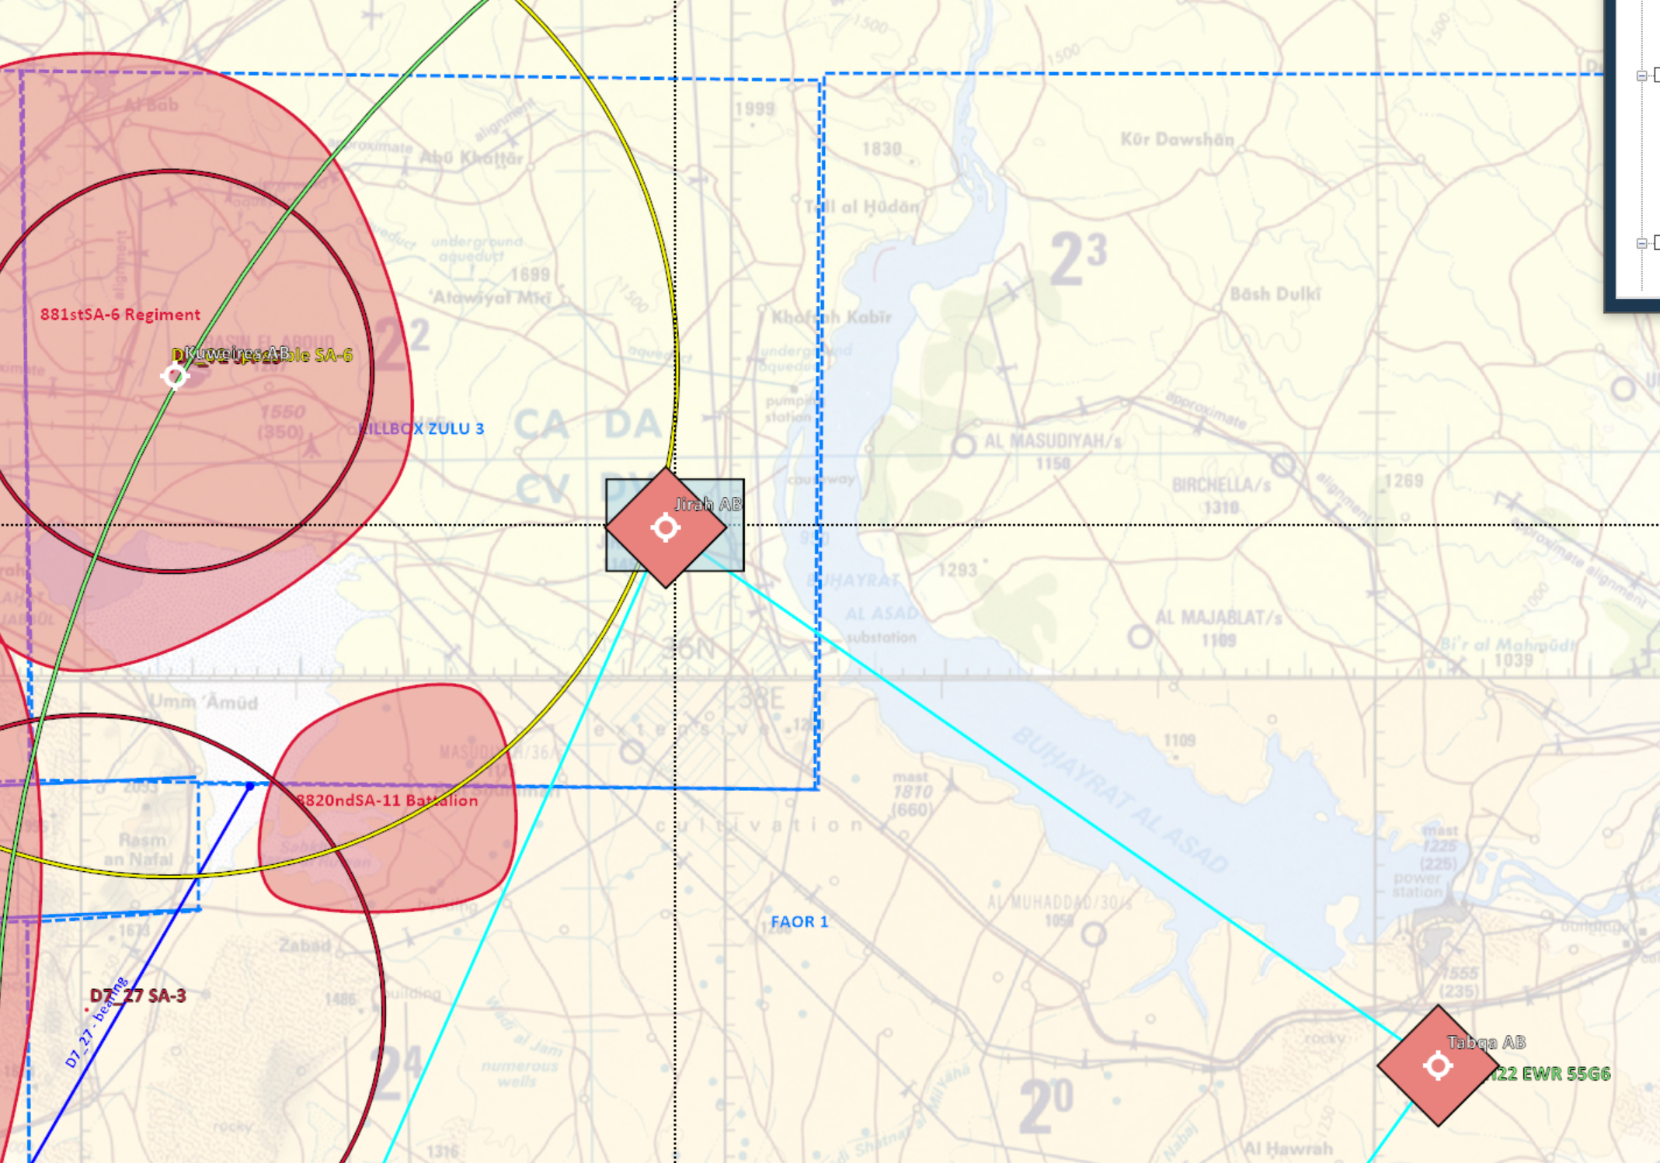
MAJOR EVENTS LAST PERIOD
Backup SDACC center East (OPARTGT104)destroyed in sector East at Jirah AB. With both Jirah AB (OPARTGT039) taken out of action for at least 72 hours.
Key Surface to Air threats degraded/destroyed in Northern Killboxes.
Several MIG29s and MIG25s reported shot down between Jirah and Tabqa.
No losses to friendly aircraft due to hostile activity.
INSERT MAP HERE
A
A
B
B
C
C
D
D
E
E
F
F

Slide 3
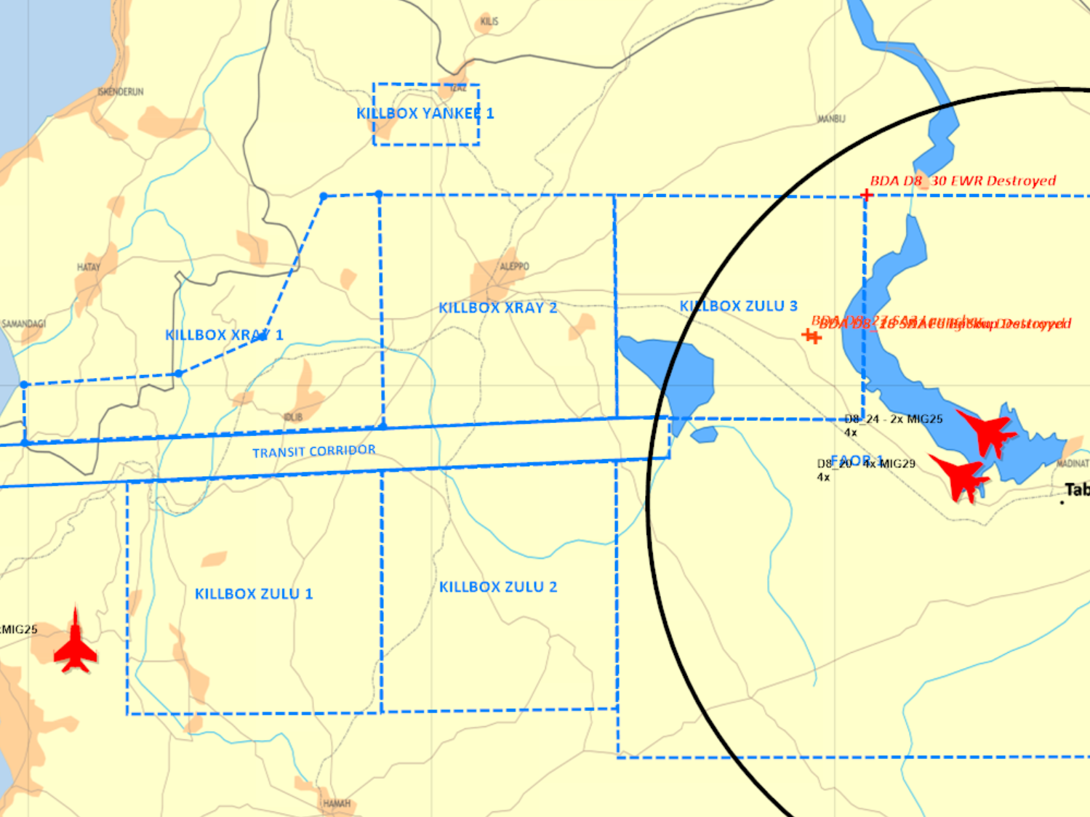
IADS BATTLE DAMAGE ASSESMENTS
Syrian Sector West and East D+8 IADS elements
D8_18 SDACC Backup Center East - Destroyed IVO Jirah. (OPARTGT104)
Jirah AB (OPARTGT039) primary DMPIs hit. Airbase out of operation for at least 72 hours.
D8_19 2xMIG25 shot down IVO W KBZ1.
D8_20 4xMIG29 shot down IVO Tabqa.
D8_24 2xMIG25 shot down IVO Tabqa.
D8_26 SA2 Fan Song - Destroyed IVO Jirah.
D8_27 SA2 Launcher - Destroyed IVO Jirah.
D8_30 EWR - Destroyed NE KB Z3.
INSERT MAP HERE
A
A
B
B
C
C
D
D
E
E
F
F

Slide 4
IADS FORCE ATTRITION D+8
Syrian Sector West and East D+8 IADS elements
SECTOR WEST
SDSCC Near Abu Al Duhur AB is destroyed.
No reports of Backup Center exist.
8411 SA-2BN remains at 42% strength and is estimated combat ineffective.
8312 SA-3BN remains at 89% strength, is degraded but estimated combat effective. No Change from D+7.
SECTOR EAST
8711 SA-2BN is estimated at 83% strength and is combat ineffective due to no launchers.
8712 SA-3BN is at 89% strength. Combat ineffective due to no search radars.
8820A and 8821A SA-11 Batteries are down to 80% and partially combat effective (no Search Radars).
It is LIKELY that the enemy would prioritize replenishing these units.
INSERT MAP HERE
A
A
B
B
C
C
D
D
E
E
F
F

Slide 5
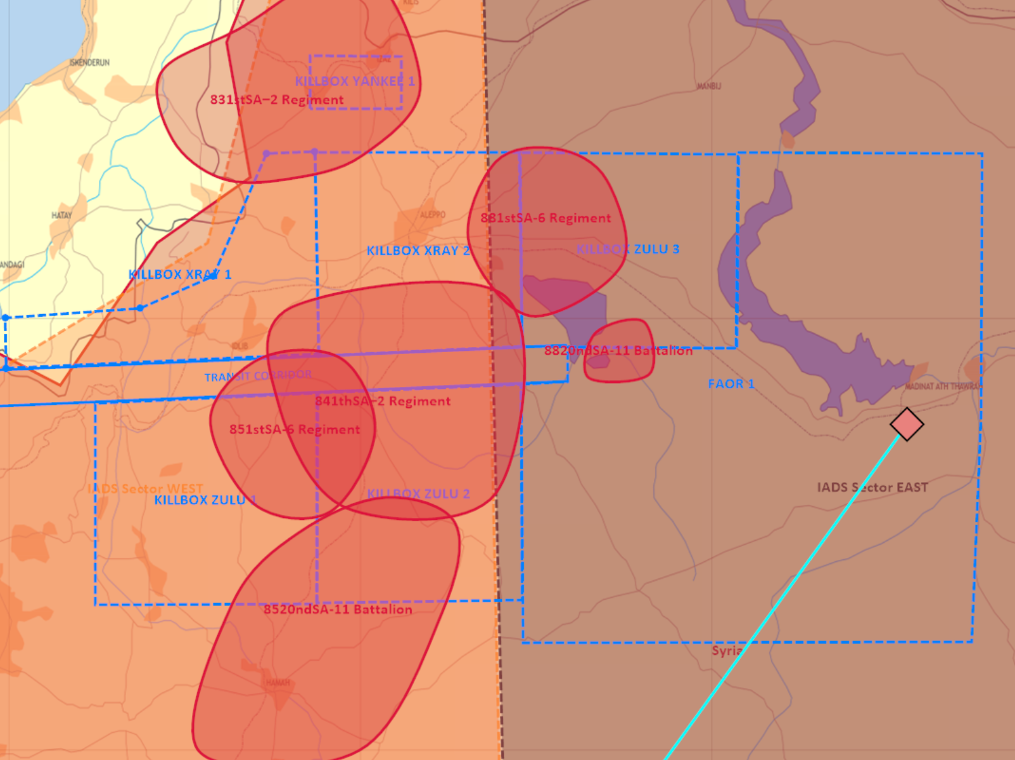
ASESSMENT OF ENEMY IADS DISPOSITION D+8
VIS assesses that the overall disposition of SA regiments and battalions in sectors West and East remain unchanged from D+7.
A. 831st SA-2 Regiment – Static.
Likely tasked with the area defense of Minakh AB.
Combat Ineffective.
B. 851st SA-6 Regiment – Movement unknown.
Likely tasking undetermined. Combat Ineffective.
C. 8520nd SA-11 Battalion – Movement unknown.
83% strength – Combat Effective.
Likely tasked with the area defense of Hama AB.
D. 8820nd SA-11 Battalion – movement unknown.
Likely tasked with the defense of approach to Tabqa AB. Combat ineffective - Search Radar destroyed.
E. 841st SA-2 Regiment. - Static
Likely tasked with the area defense of Abu Al Duhur AB.
INSERT MAP HERE
A
A
A
A
B
B
C
C
D
D
F
E
E
F
F
D
B
E
C

Slide 6
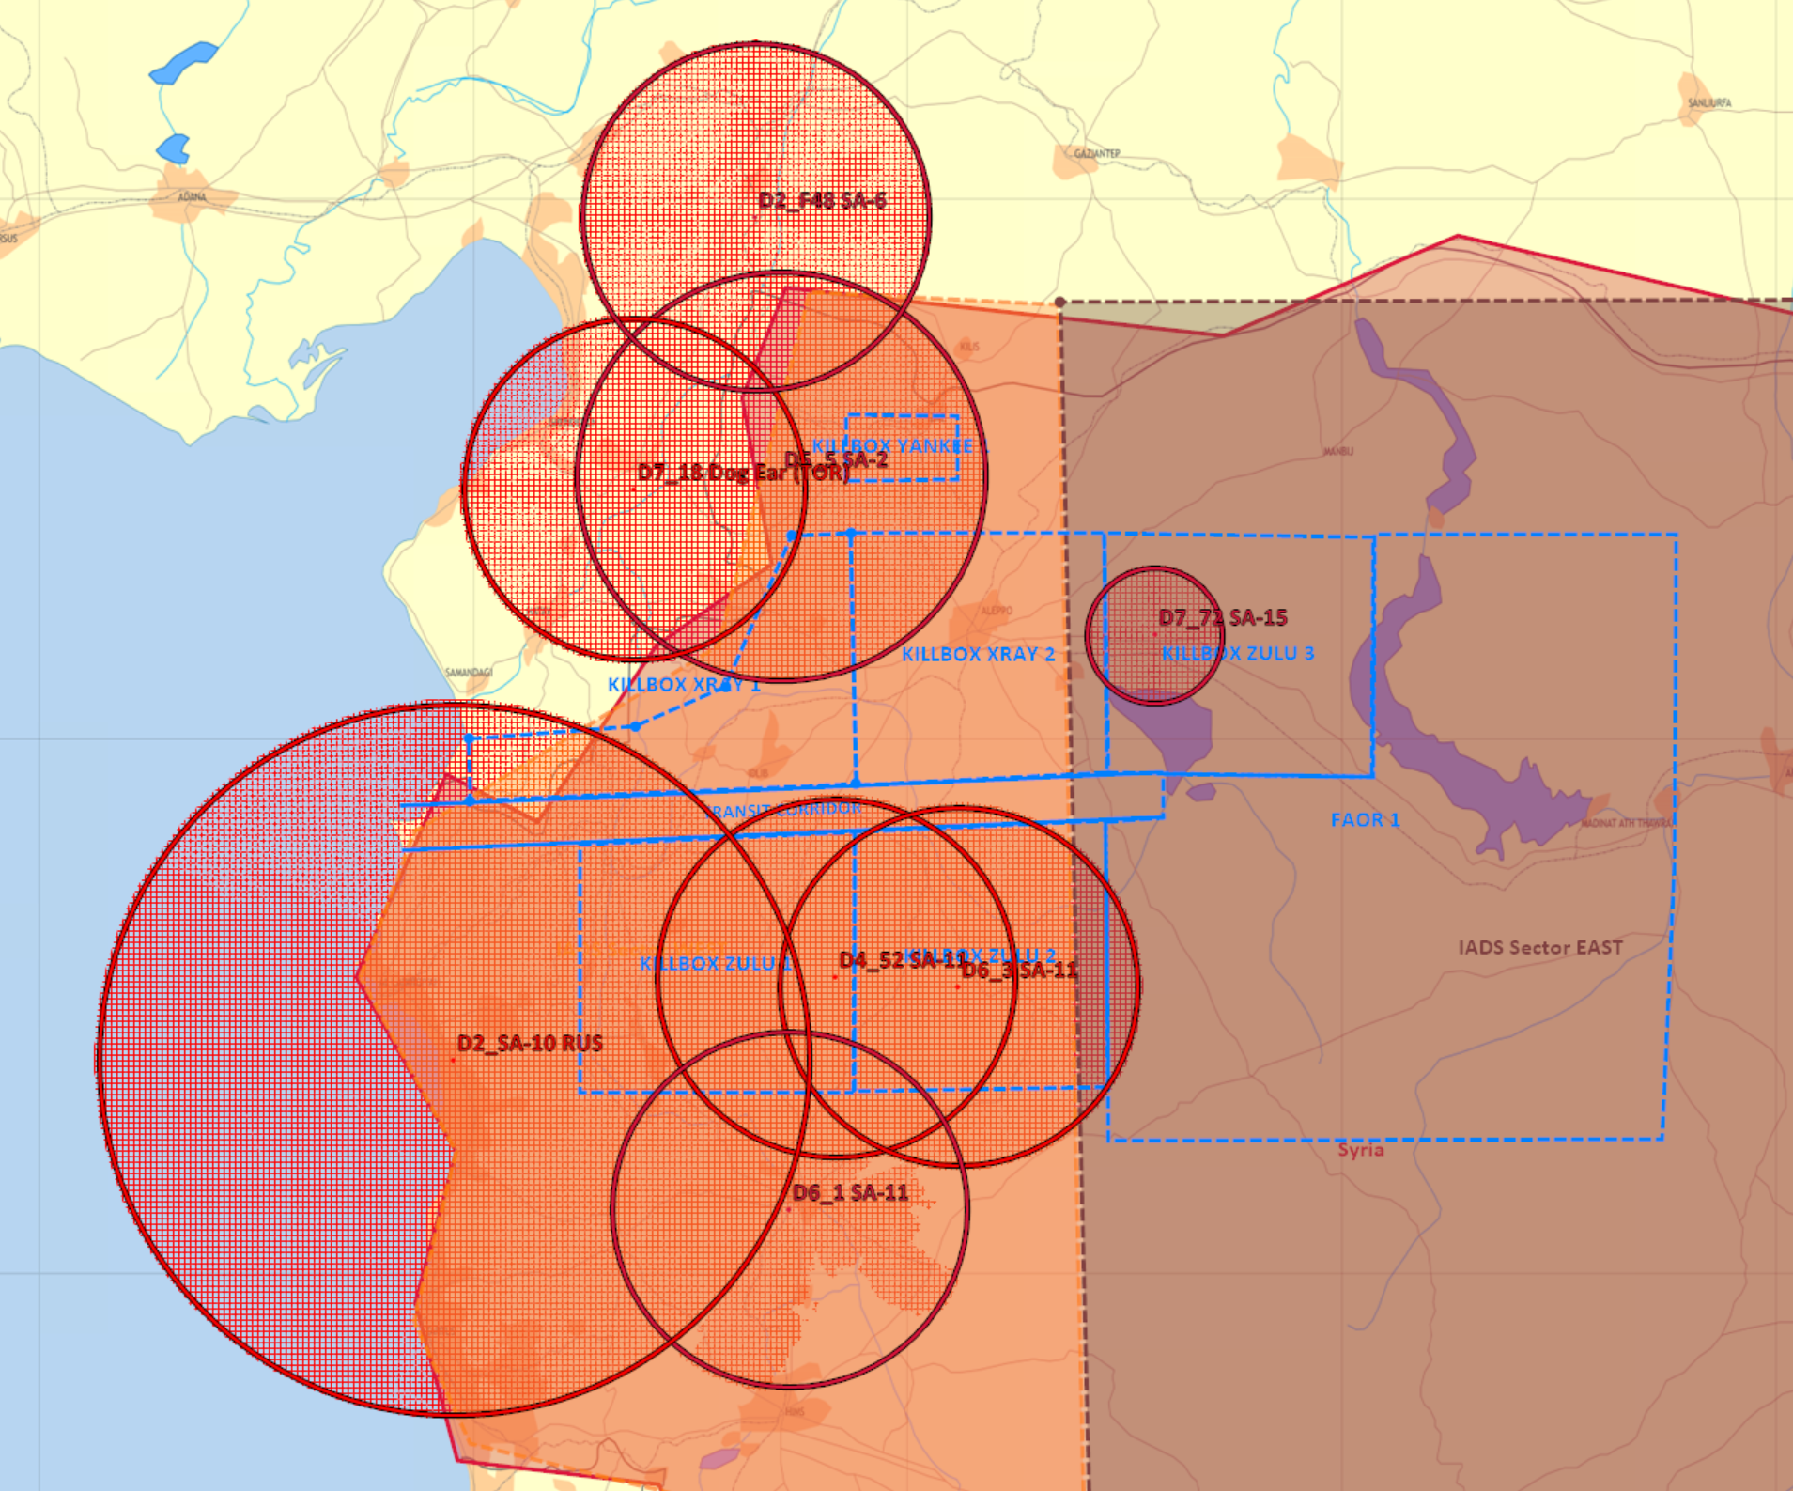
IADS HIGH ALT THREATS D+8
Current medium ( 25K ft ) threats consist of SA-6, TORs and SA2s IVO KB Yankee in the NW part of the AOR as no reports can be correlated to their destruction.
The northern part of the transit corridor is assessed as mostly safe from Syrian Air Defense in the medium to high altitude regime and permissible for ALR-Medium operations.
Several SA-11 sites remain a threat south of the D+8 TC.
The presence of a Russian SA-10 at Al-Bassad remains a potential high threat to air operations. VIS recommends that the TC be adjusted towards the green lanes depicted to mitigate threat to coalition forces.
INSERT MAP HERE
A
A
A
B
B
C
C
D
D
E
E
F
F

Slide 7
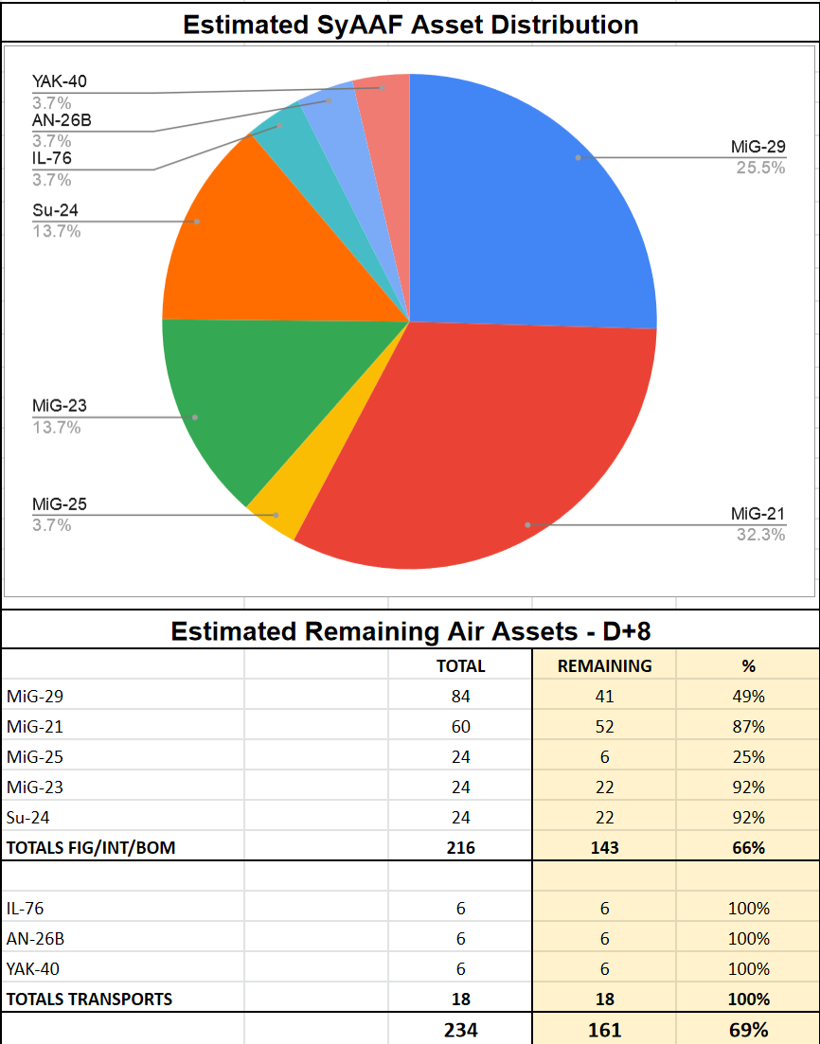
SYRIAN AF STRENGHT ASESSEMENT
It is estimated that the enemy air order of battle has been severely attritted based on assessments from reports. 4th Generation ( MIG-29 ) airframe numbers are estimated down to 49% of their original strength and all but 6 MIG-25 have been destroyed leaving them down to 25% strength. Overall estimated 66% remain of Fighters/Interceptors and Bomber aircraft, limiting the ability to sustain offensive and defensive air operations.
A
A
A
B
B
C
C
D
D
E
E
F
F

Slide 8
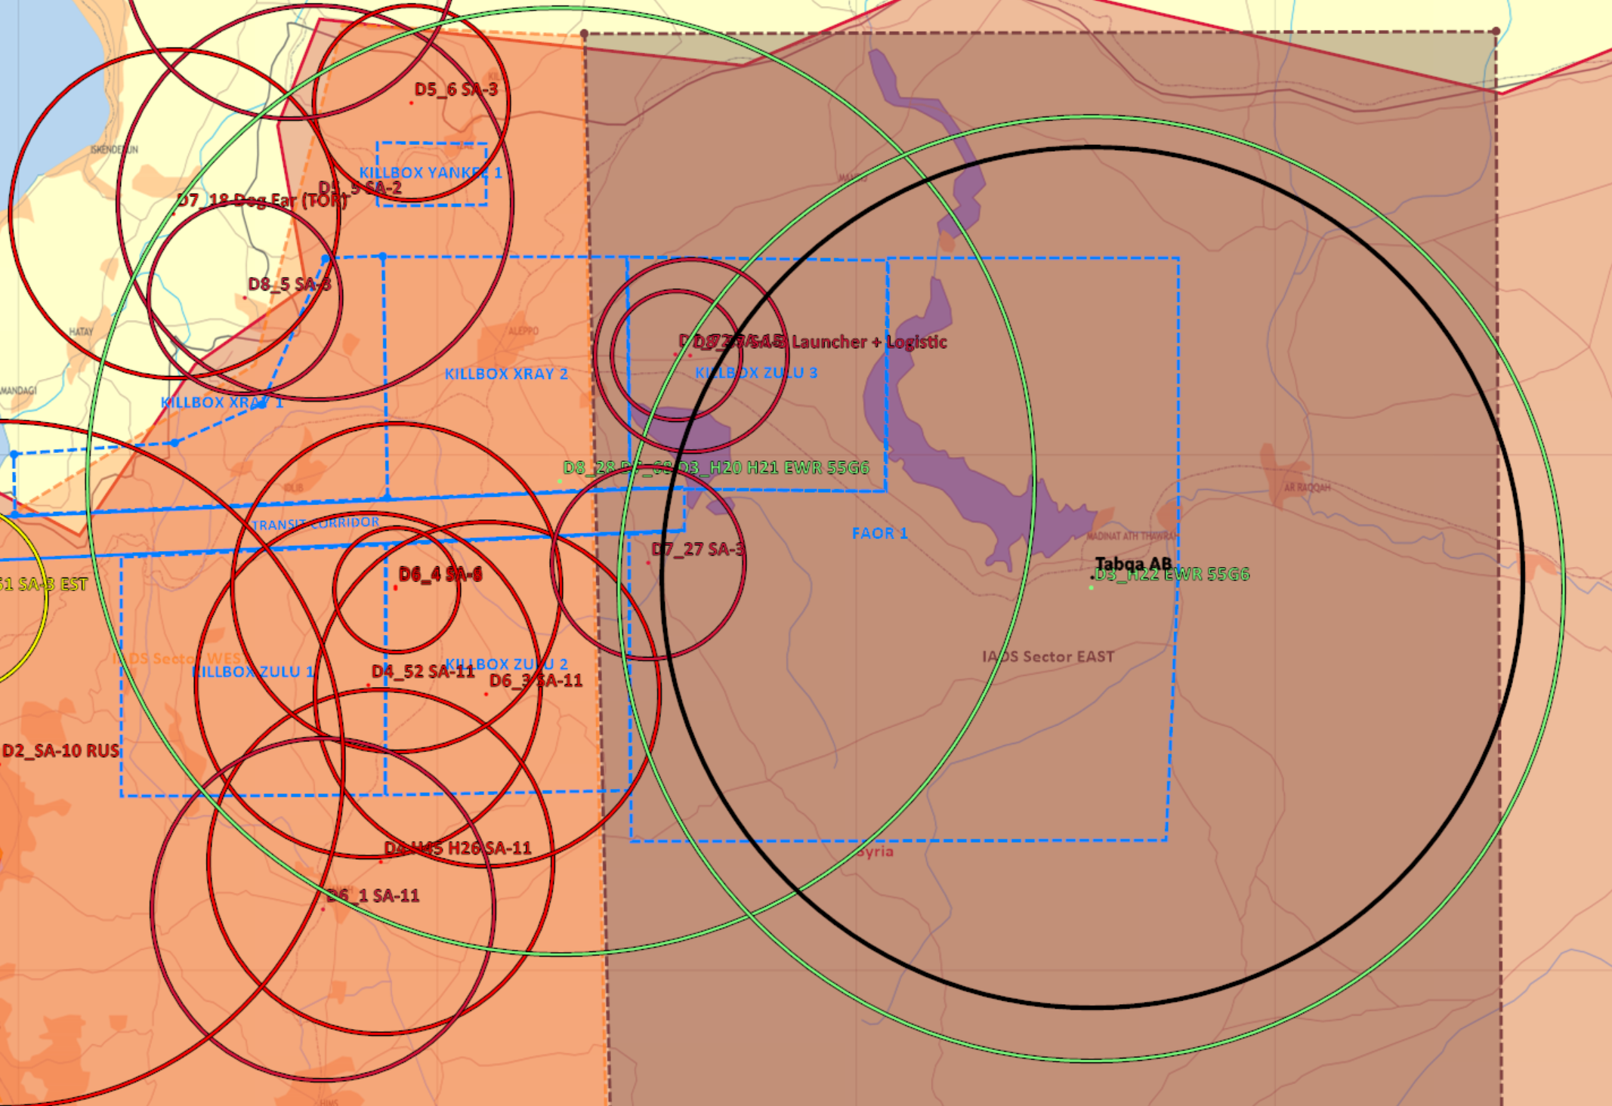
IADS THREAT SUMMARY AND RECOMMENDATIONS
Current threats posed by surface to air sites have been significantly mitigated north of the TC.
With Jirah AB out of the picture, the ability to gain and maintain air superiority is further enhanced.
Jirah Backup SDACC destroyed on D+8 airstrike paves the way for potential follow-on strikes at Tabqa AB and its SDACC which is the single remaining airbase in the North sector generating sorties against our forces.
VIS suggests that along with Tabqa AB - follow up strikes on Jirah and Abu Al Duhur be conducted to ensure they remain inoperable, as well strikes towards remaining EWR sites in the sector.
Limited intel is available for the composition of air defenses IVO Tabqa. It is ASSESSED that SA-11 Search radars destroyed on D+5 and D+7 IVO Jirah AB belong to the 8820nd SA-11 BN which is the only one assigned to EAST sector according to OOB intel. Thus it is LIKELY that Tabqa is protected by SA6s, SA2s and SA3s.
INSERT MAP HERE
A
A
B
B
C
C
D
D
E
E
F
F

Slide 9
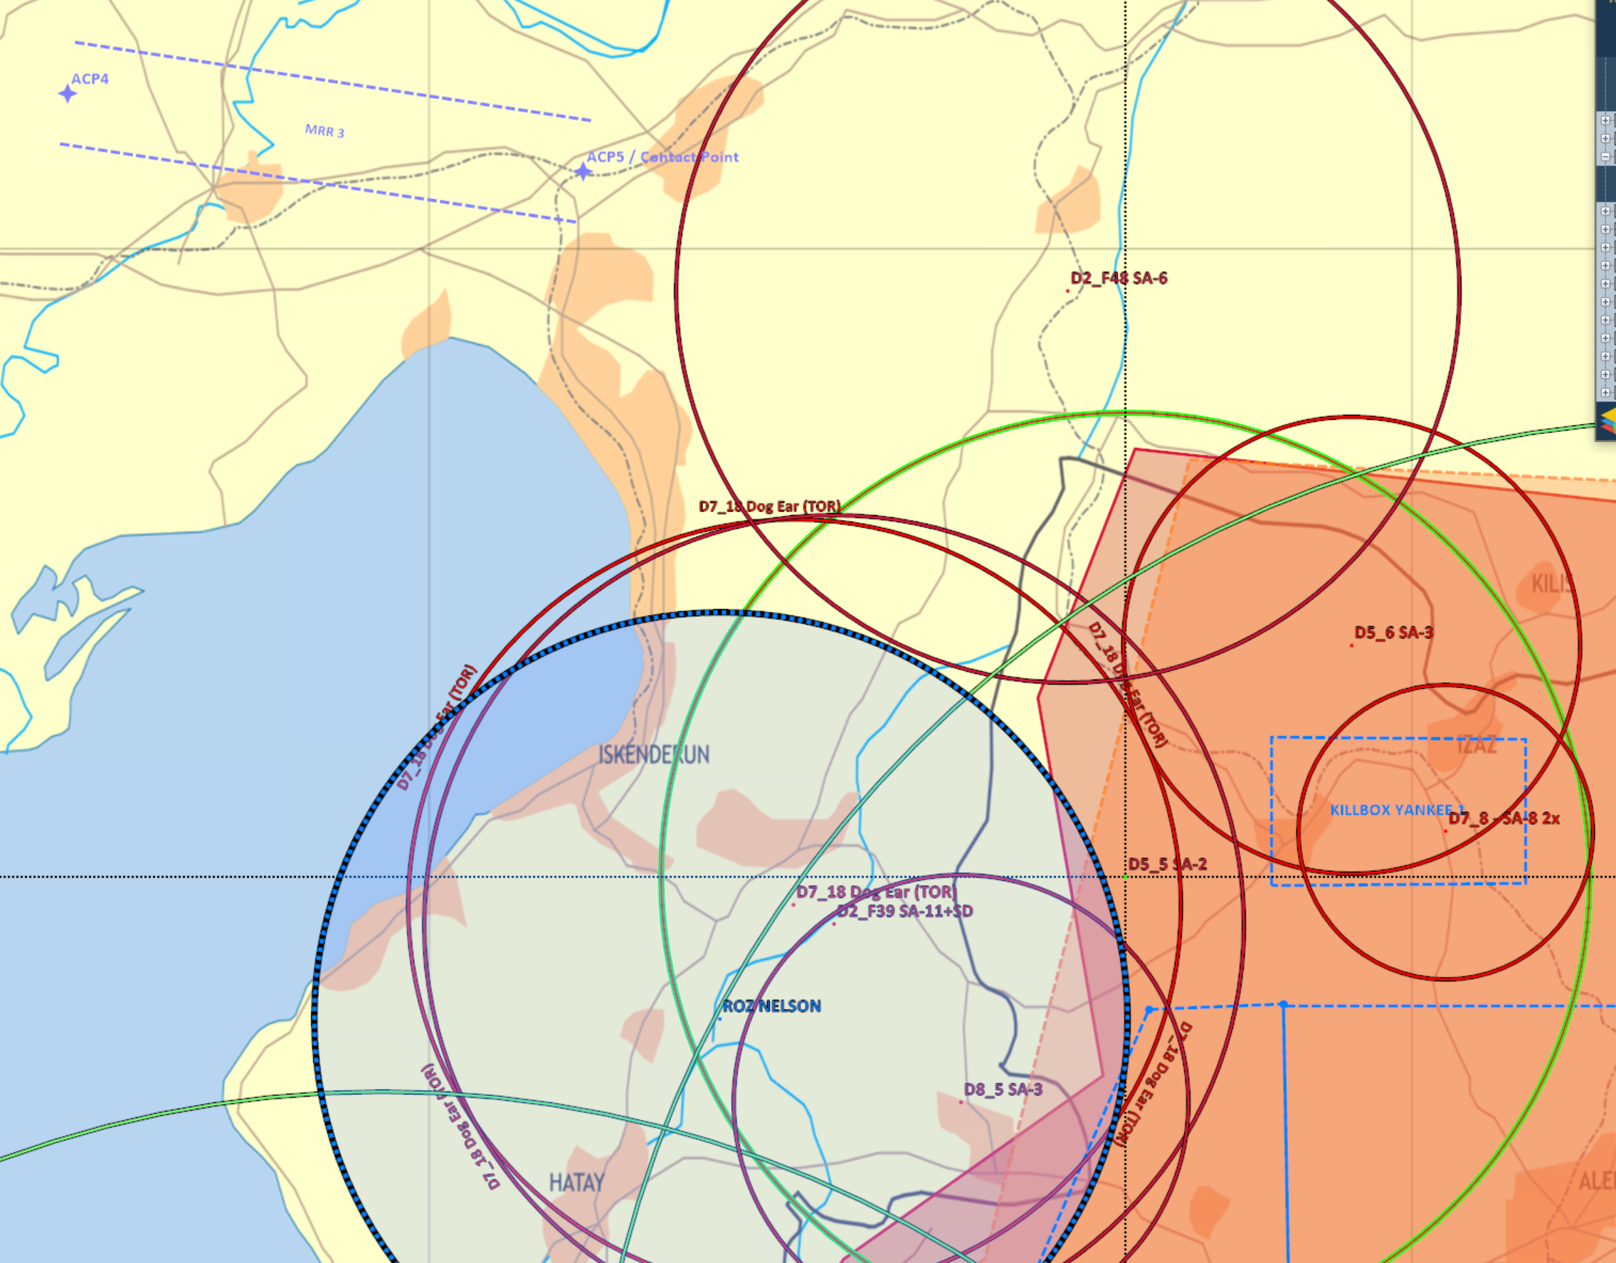
INTELLIGENCE GAPS
What is the scheme of manouver (SOM) of mobile SA regiments?
Has the Syrian AF been flying CAPS? If so - where and how long.
Unconfirmed D8 reports of A50 ESM activity due south from Carrier Operations Box. Further information is desired.
Reports of Drone flights IVO Al-Assad - where are they flying and what is their purpose.
What is the status of AD IVO ROZ Nelson in particular D2_F39 SA11 and D2_F48 SA-6.
A
A
B
B
C
C
D
D
E
E
F
F

Slide 10
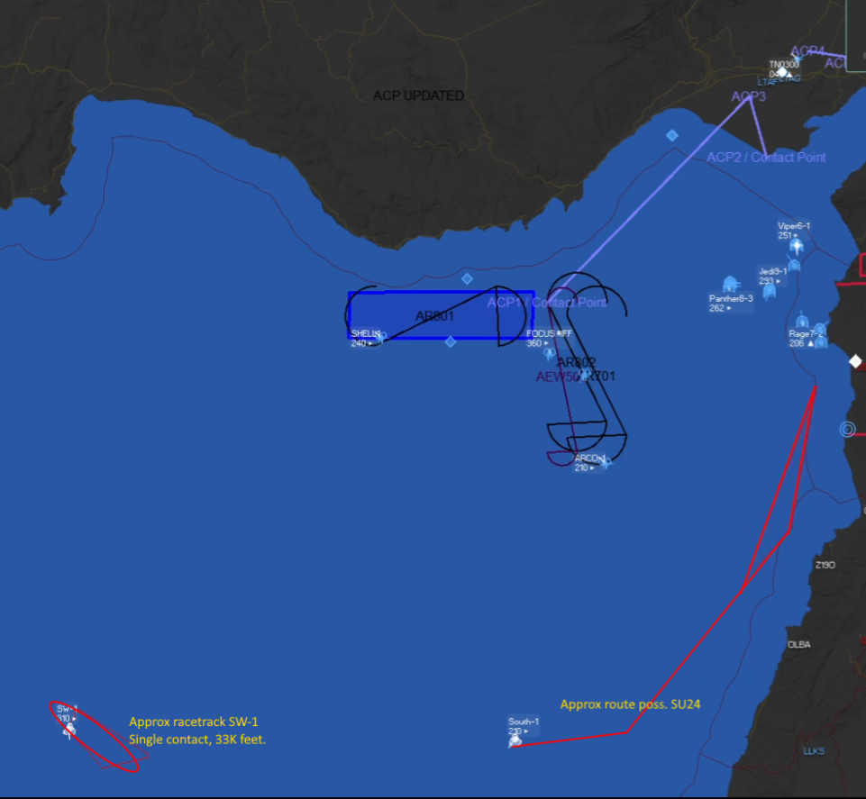
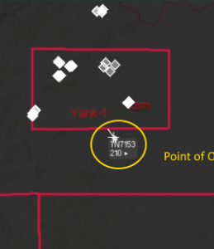
INTELLIGENCE GAPS FILLED
Russian forces confirmed present in Bassel Al-Assad - SA-10 , Hinds, Drones, at least two armed SU-27s and four SU-34s.
QRA - reaction times assessed 10-15min (D2_F30 - Mezzeh AB - D8 MIG29 QRAs).
Identified EWR sites still active in North Sector. D8_28 - D3_19 EWR 55G6 N 35 24.000 E 035 57.000 D3_H22 EWR 55G6 N 35 44.500 E 038 33.500
4. What are the minimum risk zones available to fly at medium-high blocks? - North of the TC corridor has been assessed as acceptable to ALR medium operations as shown on previous slides. Other areas remain high risk without effective SEAD.
5. Possible HVA ( AEW ) detected as shown. MSNO C20129. Low Level flights by SU24s detected along the coastline and Drone flights in KB Yankee.
A
A
B
B
C
C
D
D
E
E
F
F

